Slide 1
Group Multi-Role Assignment
Lab 2 | Qian Jiang
MUST | F.I.E
The email address to submit assignments is ecargo@aliyun.com
论文提交到该邮箱：ecargo@aliyun.com

Slide 2
Content
Preliminary Knowledge
Objectives
Assignment
Turn in Requirement
Notes:
This lab lesson is divided into four parts. First, we will introduce some preliminary knowledge about Group Multi-Role Assignment or the relevant programming information to solve this model. Next, we will talk about the objectives for this lesson. Then, we will talk about the assignment for this lesson and its requirement. (Next slide)

Slide 3
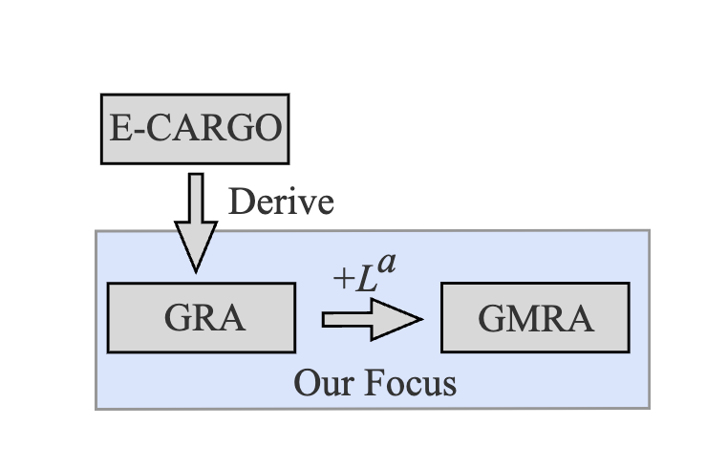
Preliminary Knowledge-Preview
Group Multi-Role Assignment (GMRA) is a typical submodel of the RBC methodology, and it is derived from the Group Role Assignment (GRA) submodel. Compared to the GRA model, the GMRA model has broader applicability.
Development of the GMRA model
The GMRA model is derived from the GRA model.
Notes:
In the GRA model, we assume that an agent can only perform one role in the assignment process. The GMRA model, on the other hand, assumes that an agent can perform one or more roles at a time. Here, we use the vector Lª to represent the number of roles an agent can perform. The mathematical expression of the GMRA model is shown below. It is an efficient tool to solve M-M (many-to-many) assignment problems.

Slide 4
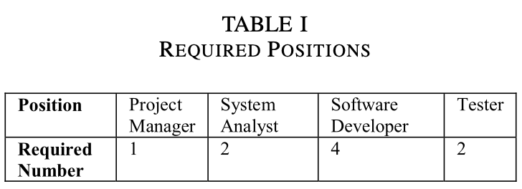
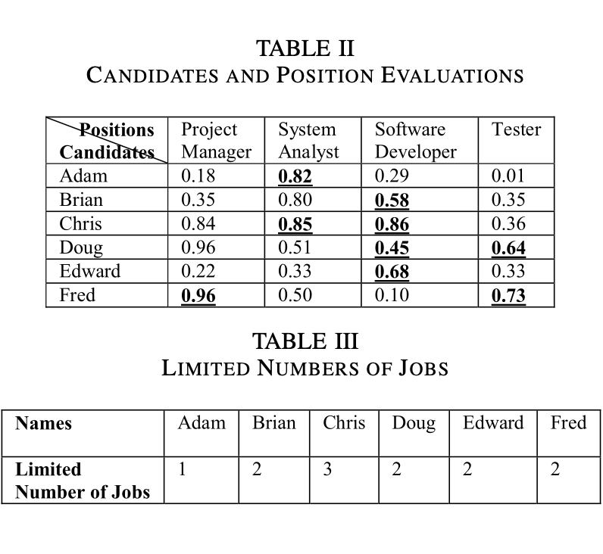
Preliminary Knowledge-A Real-world Scenario
Decision-makers of company X decides to organize a team from employees with the budget of half million dollars.
Decision-makers must assign some people to more than one position because the total number of staff members is less than that of the required positions.
Goal: Help decision-makers build the most suitable team based on current number of candidates.
Notes:
In company X, Ann, the Chief Executive Officer, has just signed a contract the value of which is half million dollars. She asks Bob, the Human Resources (HR) officer, to organize a team from employees of the company. Bob drafts a position list shown as Table I for the team and a candidate staff shortlist shown as Table II. Then, Bob initiates an evaluation process and asks the branch officers to evaluate employees for each possible position (Table II). After that, Bob informs Ann that he must assign some people to more than one position because the total number of staff members is less than that of the required positions. Ann agrees with Bob but asks Bob that if someone must be assigned with more than one job, then the jobs must be different and each person should be limited to at most three to avoid too much overloaded. Ann’s demand is reasonable because one person can shift among different jobs but not the same ones and each person should work on limited jobs to guarantee the quality of their work. Based on Ann’s request, Bob composes a table (Table III) to express the limits. Then, Ann instructs Bob to assign the most qualified candidates to jobs while satisfying the mentioned conditions.

Slide 5
Preliminary Knowledge-GMRA Model
∑ ::= <C, O, A, M, R, E, G, s₀, H>
Environments
Classes
Agents
Roles
Groups
Objects
Object-based
Agent-based
Role-based
Development of the GMRA model
Roles (Tasks): Required Positions Agents (Executors): Employees
RBC and GMRA are utilized to solve this problem
RBC and GMRA are utilized to solve this problem
Notes:
Based on the real-world scenario of the GMRA model, it is easy to deduce that the roles are the positions required by the new team, and the agents are the employees.

Slide 6
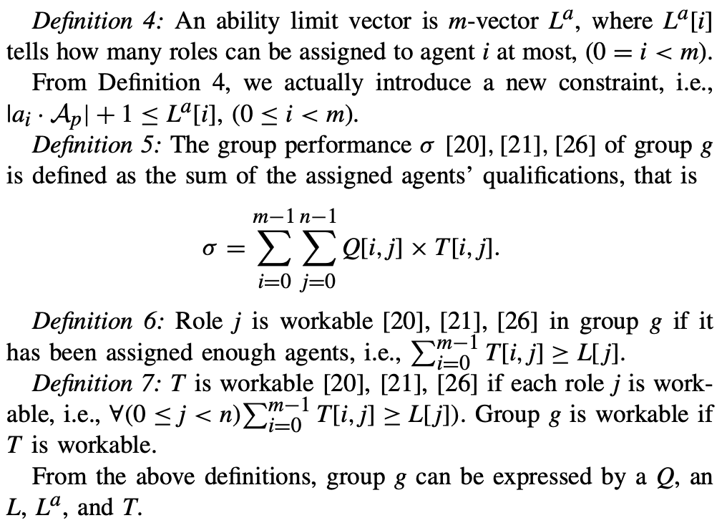
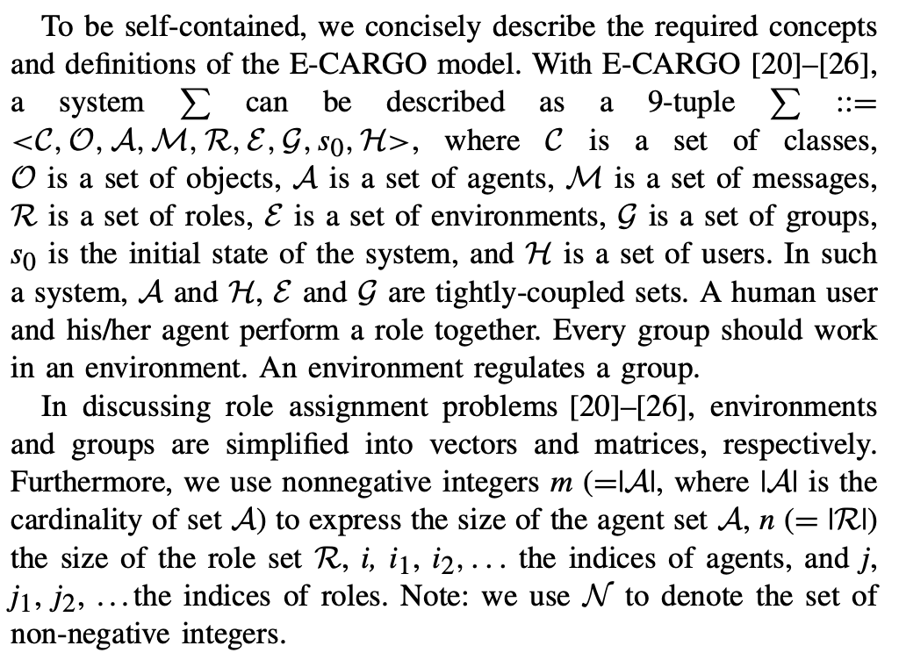
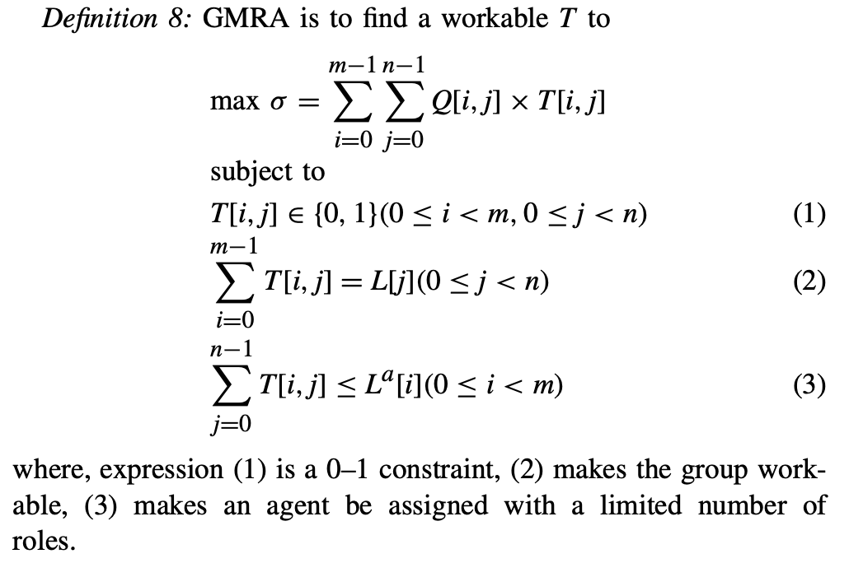
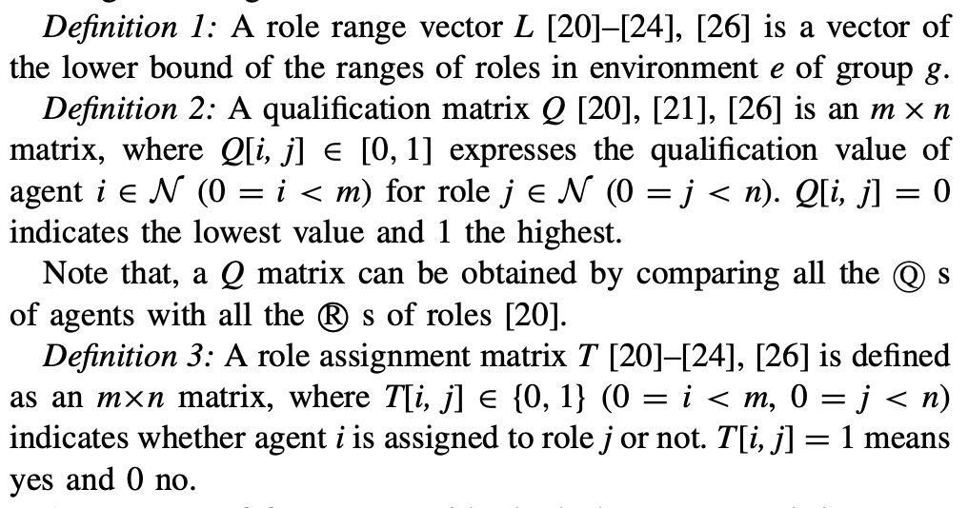
Preliminary Knowledge-GMRA Model
∑ ::= <C, O, A, M, R, E, G, s₀, H>
Environments
Classes
Agents
Roles
Groups
Objects
Object-based
Agent-based
Role-based
Notes:
Same as the GRA model, we also mathematically formalize the GMRA model. We utilize symbols i and m to express the index of agents and the size of the agent set, respectively, and, we also use symbols j and n to express the index of roles and the size of the role set, respectively. Definitions 1-3 is the same as the GRA model. The biggest difference between GMRA model and the GRA model is introducing the new Definition 4 vector La to represent how many roles can be assigned to agents. Definitions 5-7 are also the same as the GRA model.
Based on above analysis, the mathematical expression of the GMRA model is illustrated as Definition 8.

Slide 7
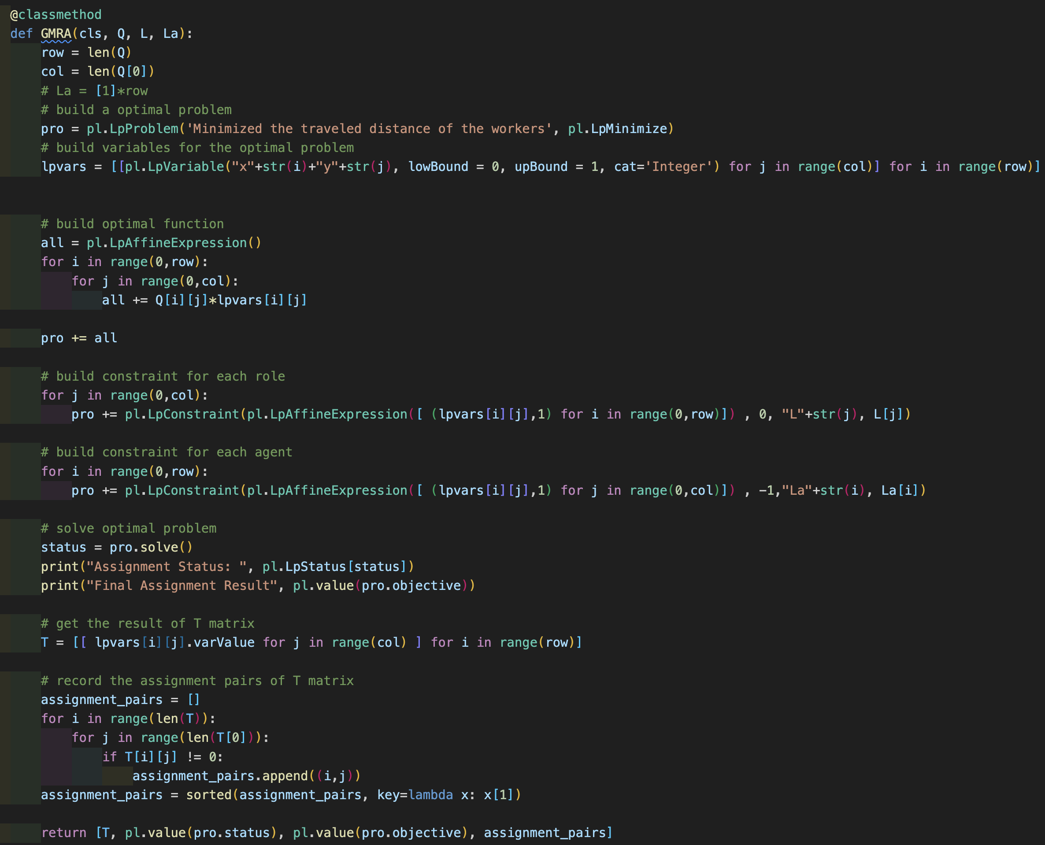
Preliminary Knowledge-Python Code Presentation

Slide 8
Content
Preliminary Knowledge
Objectives
Assignment
Turn in Requirement
Notes:
This lab lesson is divided into four parts. First, we will introduce some preliminary knowledge about Group Role Assignment or the relevant programming information to solve this model. Next, we will talk about the objectives for this lesson. Then, we will talk about the assignment for this lesson and its requirement. (Next slide)

Slide 9
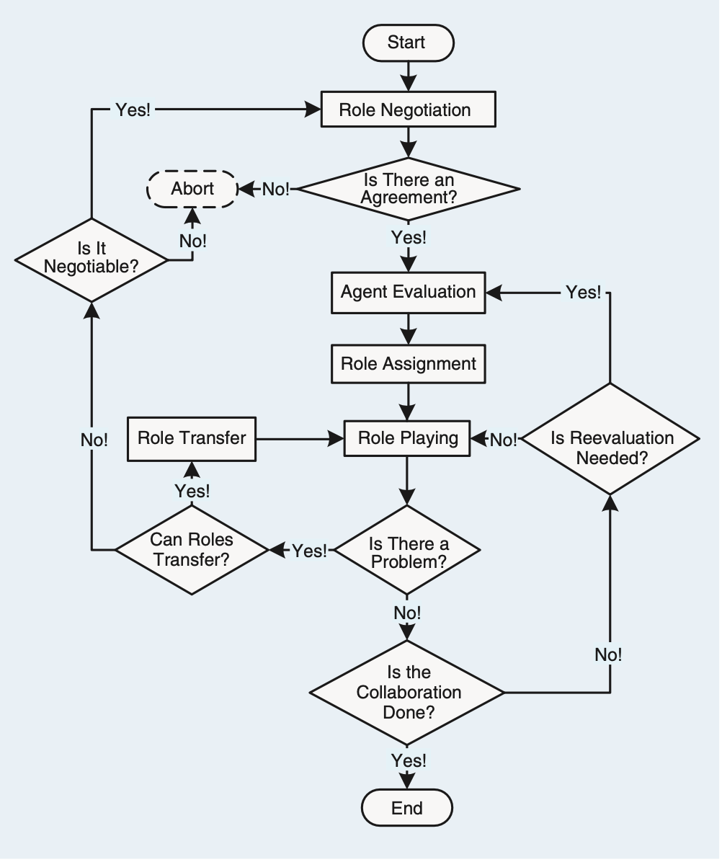
Objectives
The objectives of this course are two-fold:
1. To understand the process of RBC and learn about how to formalize problems with the GMRA submodel;
2. To practice using Python to program the GMRA model in order to solve the M-M assignment problem.
Notes:
The objectives of this course are two-fold:
1. To understand the process of RBC and learn about how to formalize problems with the GMRA submodel;
2. To practice using Python to program the GMRA model in order to solve the M-M assignment problem.

Slide 10
Content
Preliminary Knowledge
Objectives
Assignment
Turn in Requirement
Notes:
This lab lesson is divided into five parts. First, we will introduce some preliminary knowledge about Group Role Assignment or the relevant programming information to solve this model. Next, we will talk about the objectives for this lesson. Then, we will talk about the assignment for this lesson and its requirement. (Next slide)

Slide 11
Assignment
The assignment requirements for this lesson are as follows:
1. Suppose you are a manager of a company. Imagine and describe a scenario, i.e., to accomplish a complex task (RBC) by managing 30 agents (people, equipment, robots, groups of people, etc.). In addition to the scenario required for the first lesson assignment, add a constraint that each agent can perform one or more roles (tasks).
2. You need to divide the complex into smaller subtasks (Roles). Be creative, and any simple method can be used.
3. You can choose from a list of candidates (Agents) to join the team to accomplish the task. Be creative, and any simple method can be used.
4. You need to determine a list of requirements for each task (role), i.e., role specification including L and other required properties. Be creative and reasonable. Any simple method can be used.

Slide 12
Assignment
5. Suppose that every agent should have a list of qualifications corresponding to the roles’ requirements. You create the evaluation of each agent for each subtask (role), i.e., the Q matrix. Be creative, and any simple method can be used.
6. After you obtain the Q matrix, use the GMRA program (Group Multi-Role Assignment) to get the optimal assignment result, i.e., T.
7. Analyze whether the assignment is good or not from your own personal perspective. Argue why an optimized assignment result may not be the best choice.
8. Consider whether there are scalable aspects in this scenario (i.e., future works), as this is relevant to future lessons.
9. Encode and calculate assignment results using Python’s PuLP, and present the mathematical model and corresponding assignment results in the format of an IEEE paper.
10. If possible, please choose to expand the self-defined scenario from the first lesson, to make the background of the problem you are researching more generic.

Slide 13
Content
Preliminary Knowledge
Objectives
Assignment
Turn in Requirement
Notes:
This lab lesson is divided into five parts. First, we will introduce some preliminary knowledge about Group Role Assignment or the relevant programming information to solve this model. Next, we will talk about the objectives for this lesson. Then, we will talk about the assignment for this lesson and its requirement. (Next slide)

Slide 14
Turn in Requirement
1. A project report including the descriptions of your process details.
2. The report should be in the IEEE conference paper format, page limit = 2~3 pages. Refer to: https://www.ieee.org/conferences/publishing/templates.html, Choose Microsoft Word and US letter.
3. (*Vital) The paper to be submitted should include a depiction of plausible scenarios, modeling, and a reasonable interpretation of the experimental results. Furthermore, providing the source code, inclusive of the data, for the experiments could facilitate a more comprehensive evaluation.
Download the Relevant Materials:
https://github.com/jiangqian1997/E-CARGO-Codes/tree/main/Summber_School_Laboratory/Lab_2
The email address to submit assignments is ecargo@aliyun.com.

